Slide 1
Complaint Redressal System
(Group-2)

Slide 2
Team members:
FRONTEND TEAM
BACKEND TEAM
Varshit Sazal Ansarie
Venkatramanan T S
Rishu kumar Mishra
Deeksha Thakur
Siba Prasad Sahoo
Naveed Ali
Madhura Jogi
Damini Pramod Wandrekar
Ruhita Ravindra Patil
Megha Hadapad

Slide 3
Introduction:
Complaint Redressal System is a Web Application, where customers can register , Login and raise complaints regarding their landlines and broadband services.
All the complaints from customers are distributed to different managers according to complaints Zip code.
Administrator can see all complaint and perform CRUD operation.

Slide 4
Introduction:(continued)
The objective of the complaint redressal system is to make complaints easier to coordinate, monitor, track, and resolve.
Complaint redressal system is used to record resolve and respond to customer complaints, requests as well as facilitate any other feedback.

Slide 5
Tools , Languages and Frameworks used:
Front-End
Back-end
Visual studio code
Angular
Html
CSS
BOOTSTRAP
Eclipse IDE
MySQL Workbench
Postman
Spring Boot
Java

Slide 6
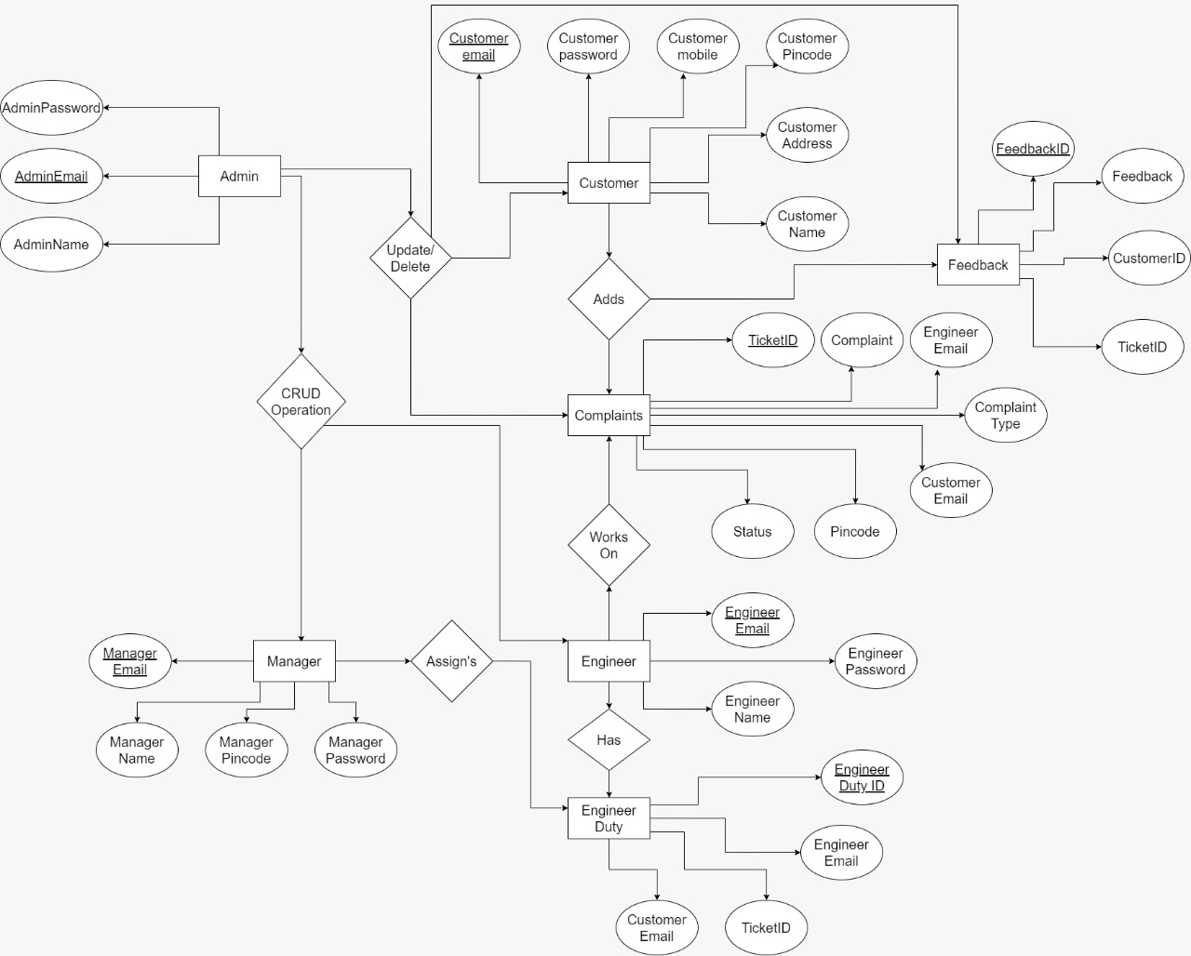
Entity-Relationship diagram:

Slide 7
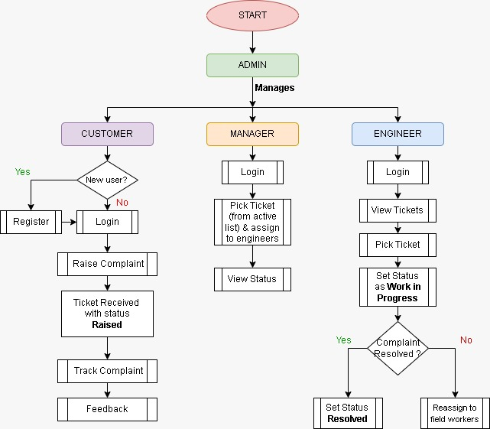
Application Flow Diagram:

Slide 8
Working:
The COMPLAINT REDRESSAL SYSTEM should support basic functionalities for all users like
1. Admin
2. Customer.
3. Manager.
4. Engineer.

Slide 9
Admin :
Admin
Login
View Managers
View Engineers
View Customers
View Complaint
View Feedback
Add Managers
Add Engineers

Slide 10
Customer:
Customer
Register
Login
Add
Complaints
Complaints Status

Slide 11
Manager:
Manager
Login
view Engineer
View Complaint
View Feedback

Slide 12
Engineer:
Engineer
Login
view Complaint
View Feedback

Slide 13
Advantages:
Customer and raise n complaints
Customer can provide feedback to the complaint
Customer has an easy UI to understand.
Fast and reliable system

Slide 14
Disadvantages:
Customer can only register with selected zip code.
Customer cannot contact customer care through chat or call .
Manager can only assign engineer based on the list displayed.
There is no validation

Slide 15
Postman Testing Outputs:

Slide 16
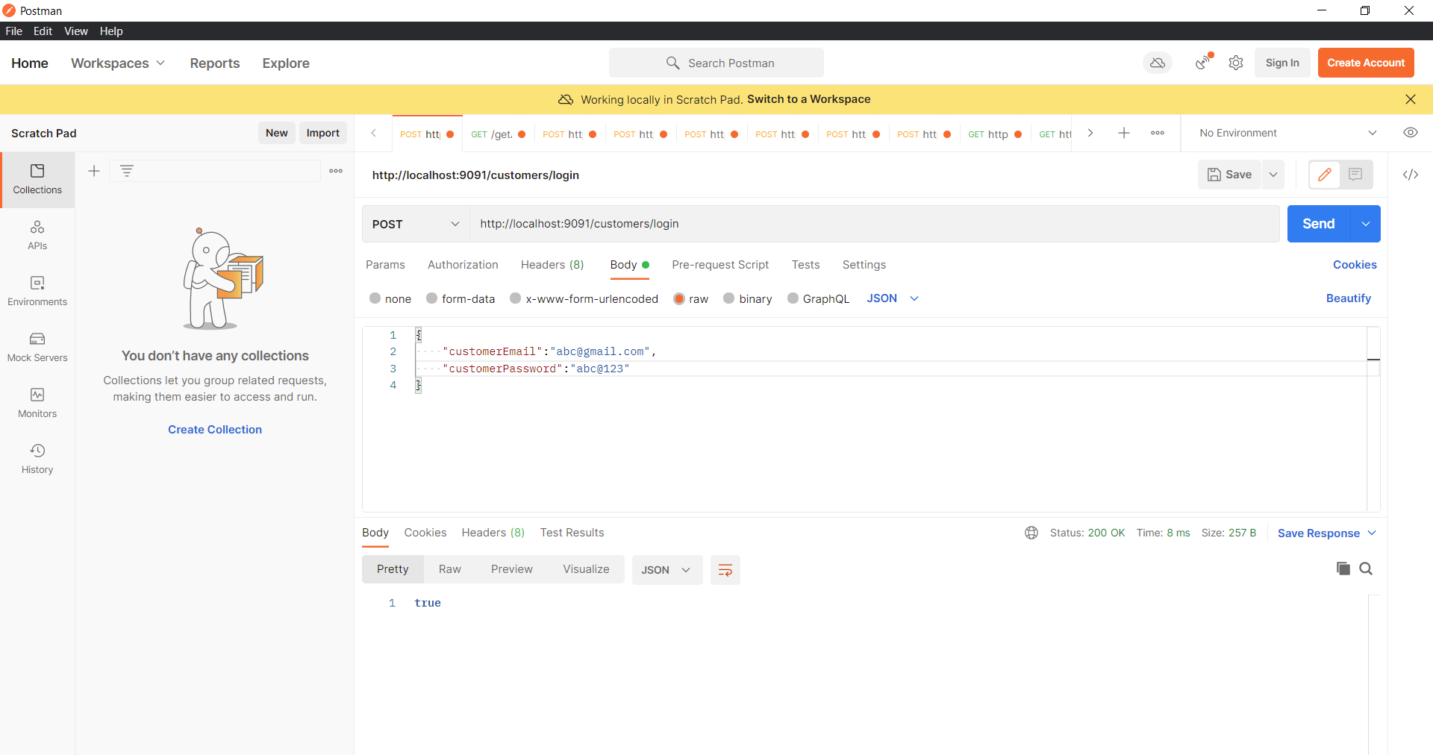
Testing for Customer Login:

Slide 17
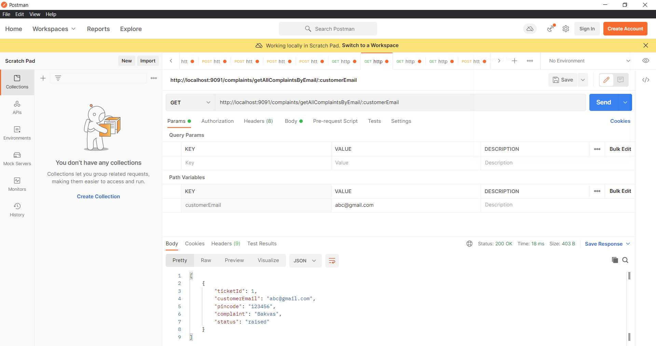
Testing for Complaints By E-mail:

Slide 18
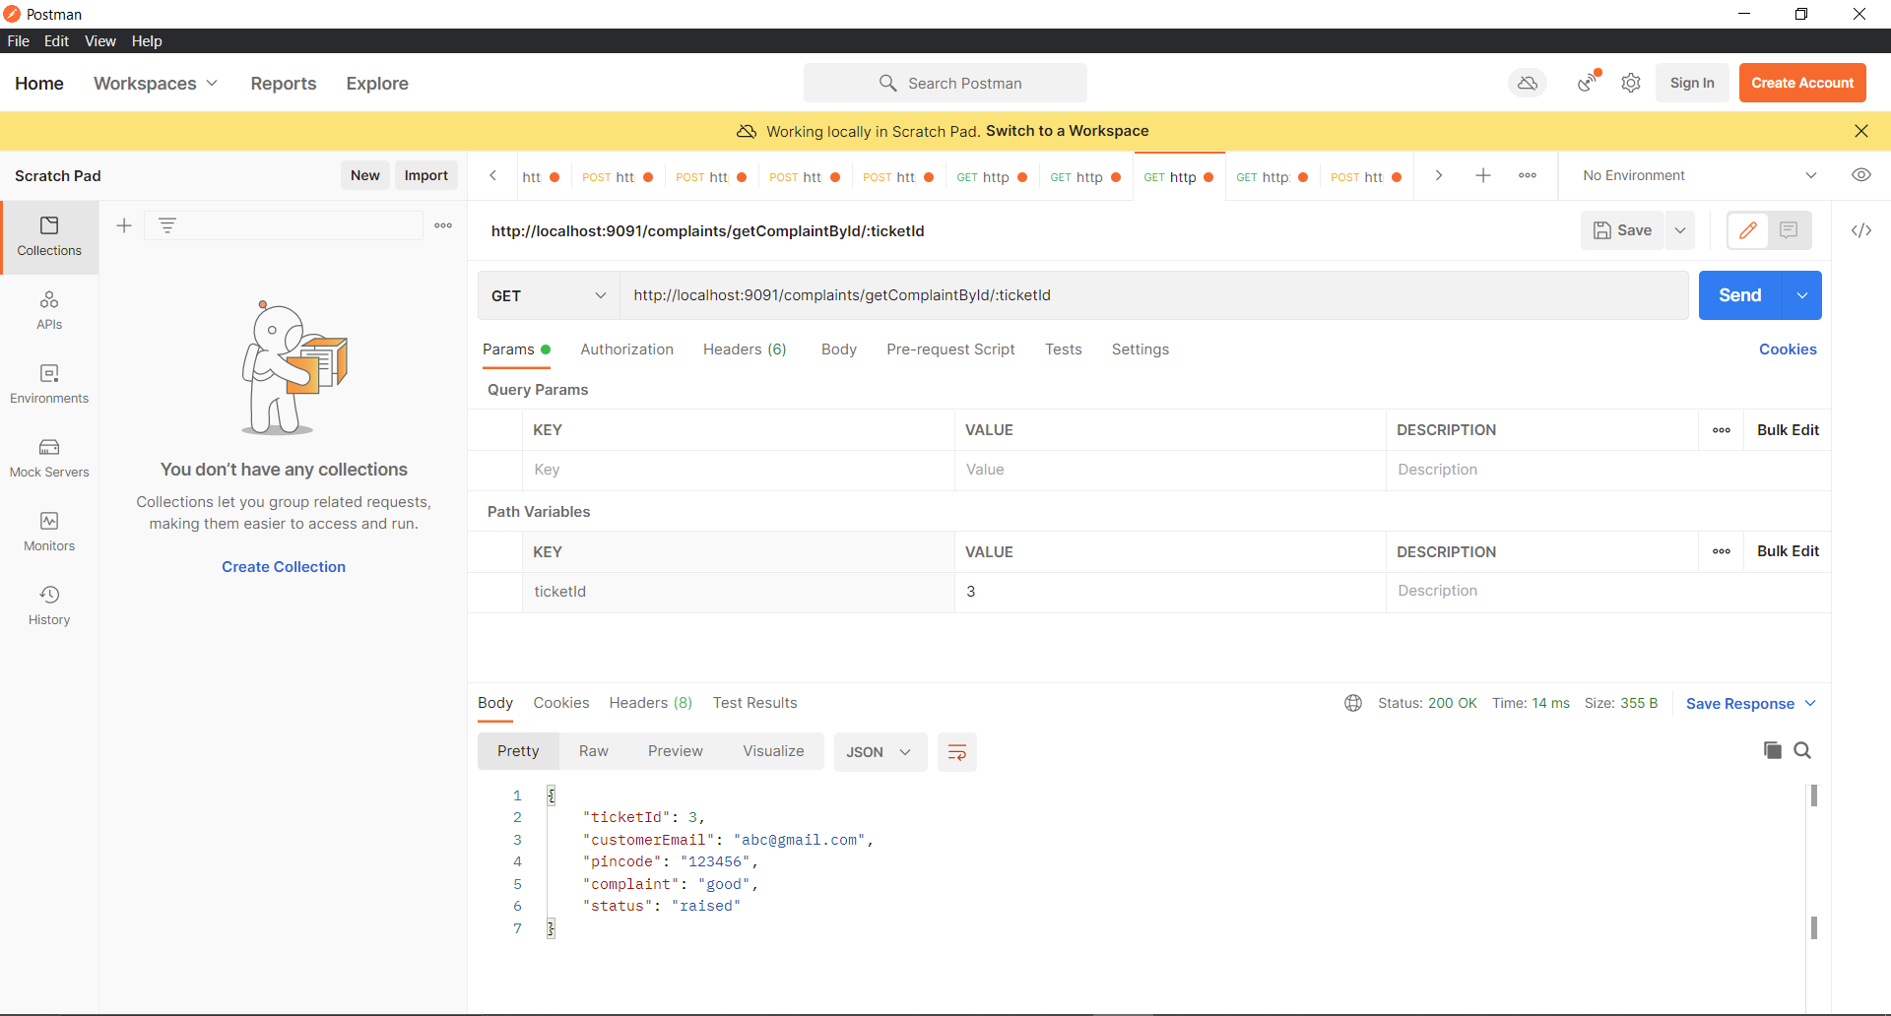
Testing for Complaints:

Slide 19
Angular work flow:
Angular is a client-side TypeScript based framework which is used to create dynamic web applications. It is very similar to its previous versions except having some extensive features.
src folder: This is the folder which contains the main code files related to your angular application.
app folder: The app folder contains the files, you have created for app components.
app.component.css: This file contains the cascading style sheets code for your app component
app.component.html: This file contains the html file related to app component. This is the template file which is used by angular to do the data binding.

Slide 20
Angular :(continued)
app.component.spec.ts: This file is a unit testing file related to app component. This file is used along with other unit tests. It is run from Angular CLI by the command ng test.
app.component.ts: This is the most important typescript file which includes the view logic behind the component.
app.module.ts: This is also a typescript file which includes all the dependencies for the website. This file is used to define the needed modules to be imported, the components to be declared and the main component to be bootstrapped.

Slide 21
Screenshorts of Output:

Slide 22
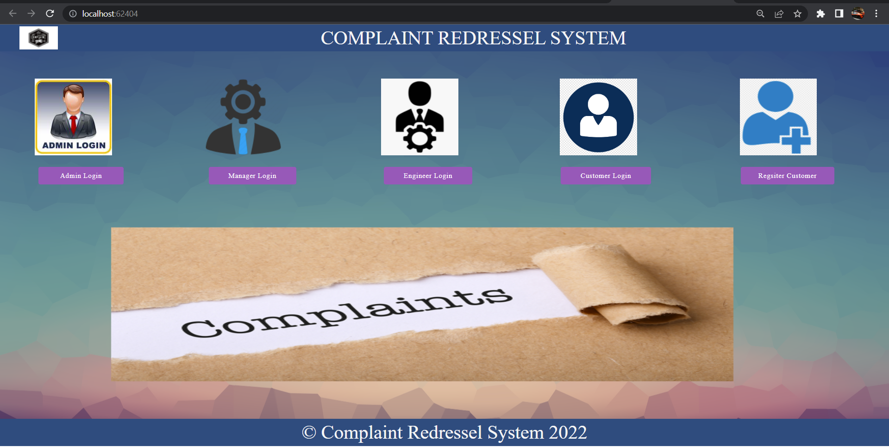
Home Page

Slide 23
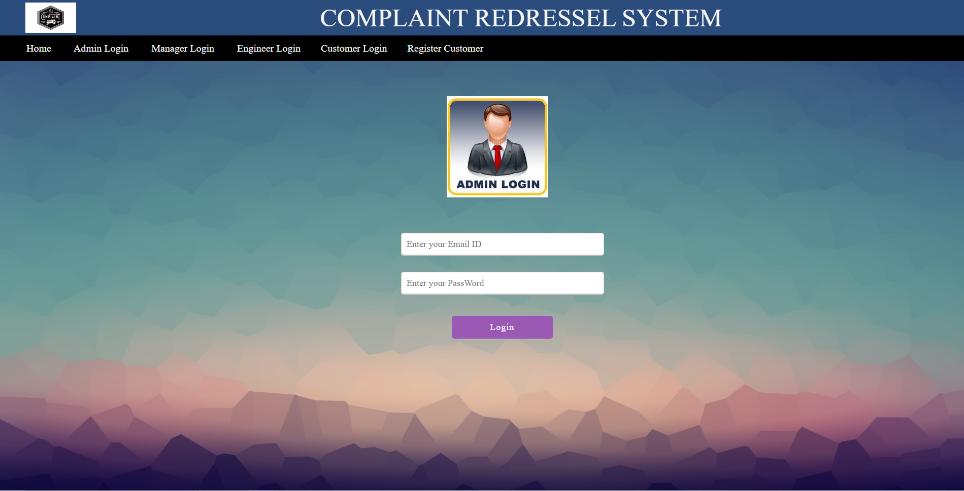
Admin Login:

Slide 24
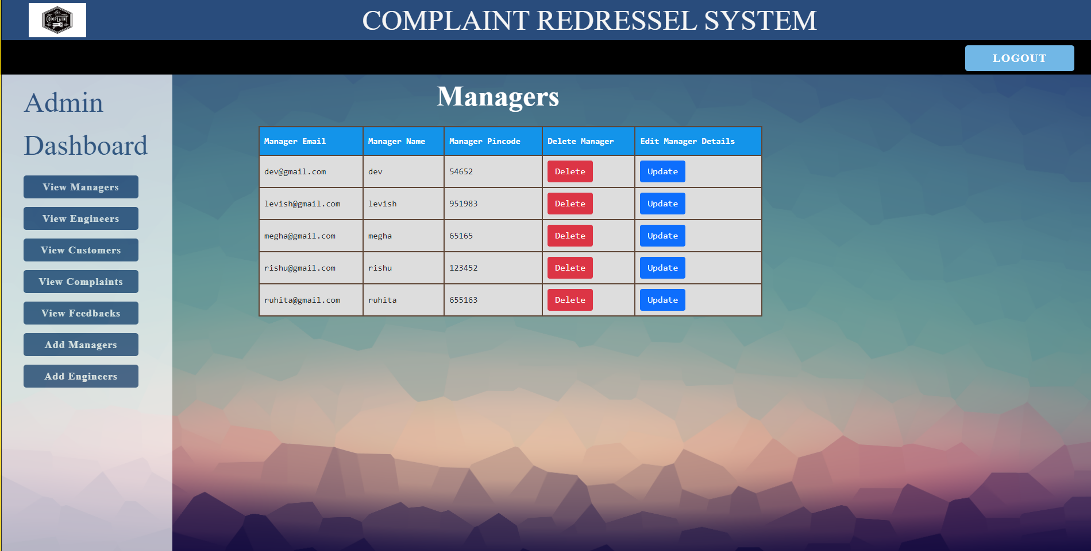
Admin can see list of Managers:

Slide 25
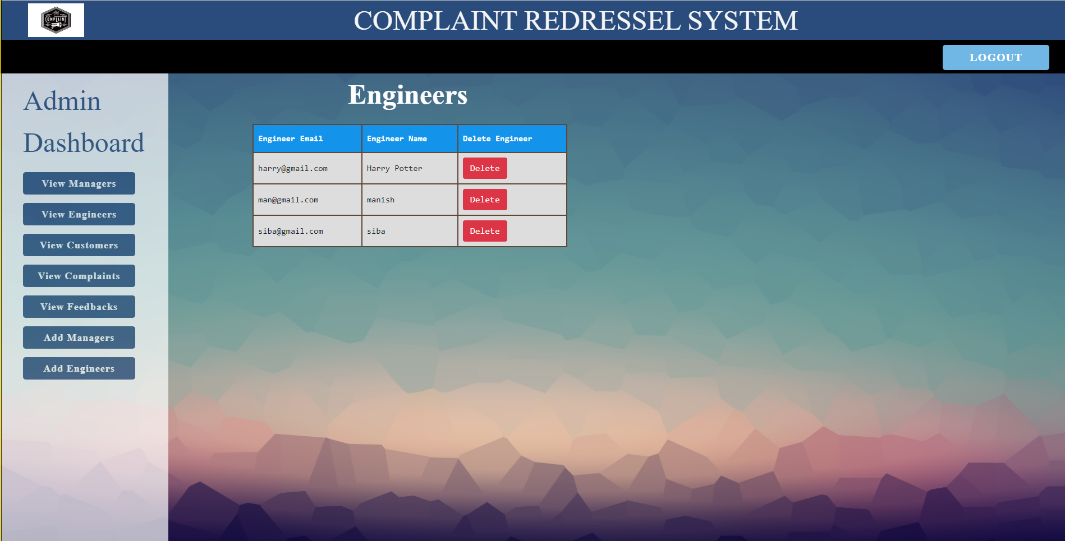
Admin can see list of Engineer:

Slide 26
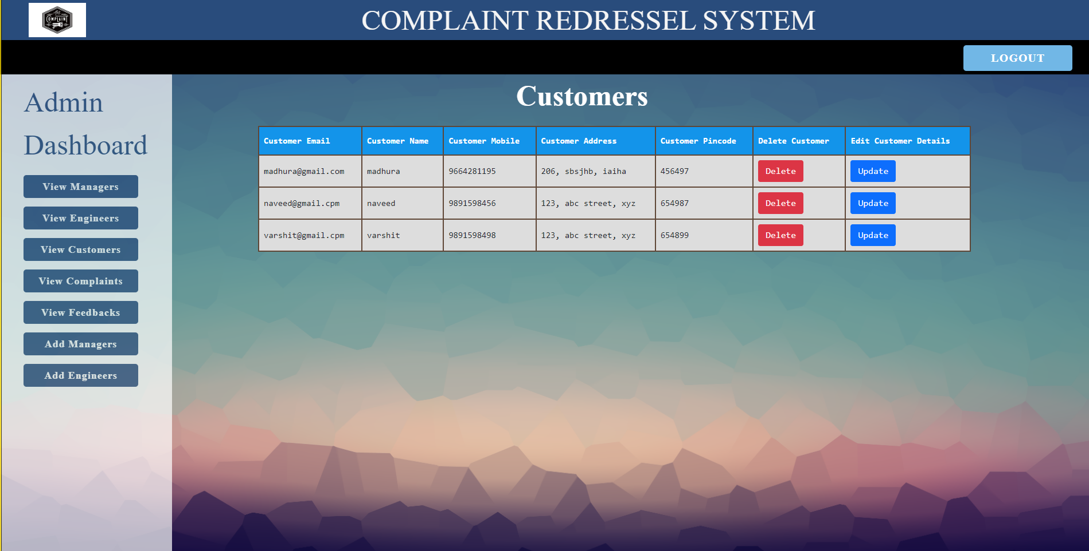
Admin can see list of Customers:

Slide 27
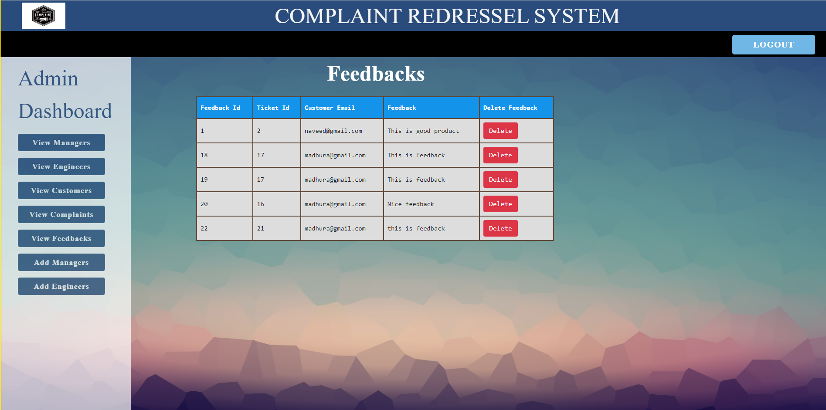
Admin can see list of Feedback:

Slide 28
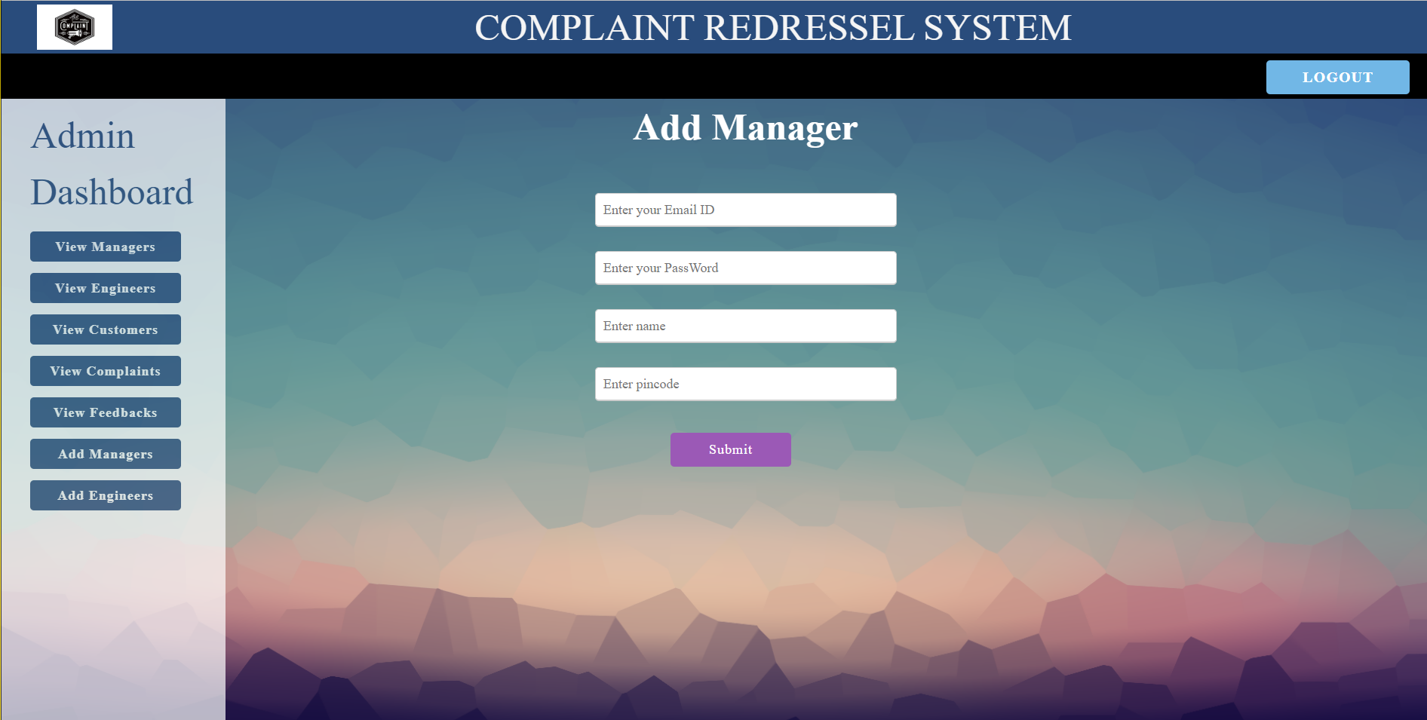
Admin can add Managers

Slide 29
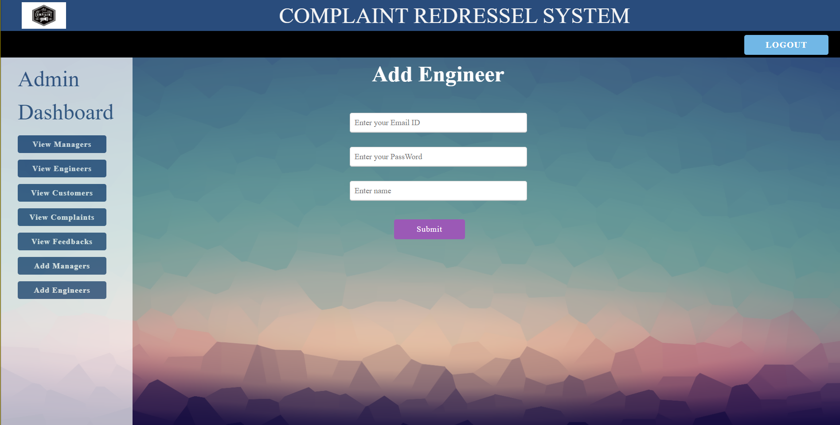
Admin can add Engineer

Slide 30
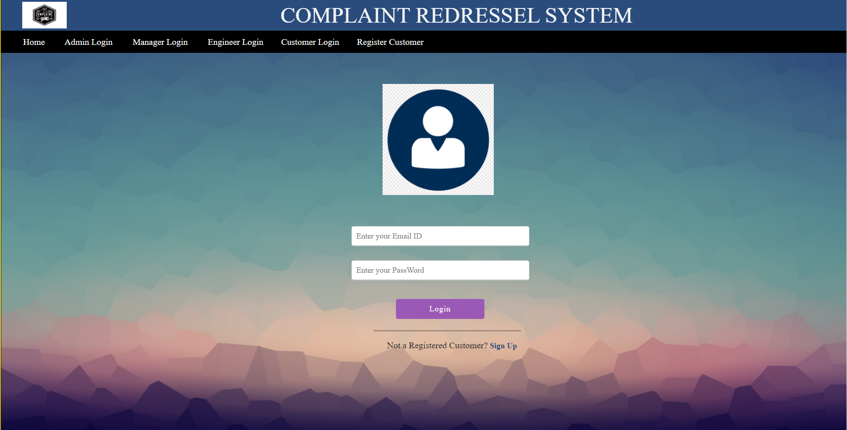
Customer login:

Slide 31
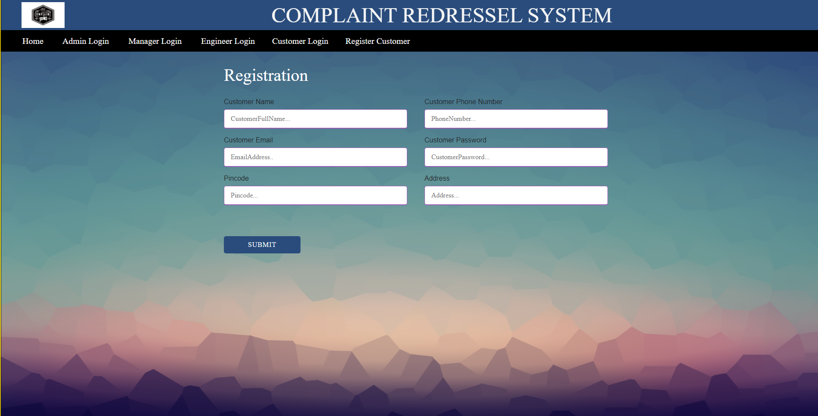
Customer can Register:

Slide 32
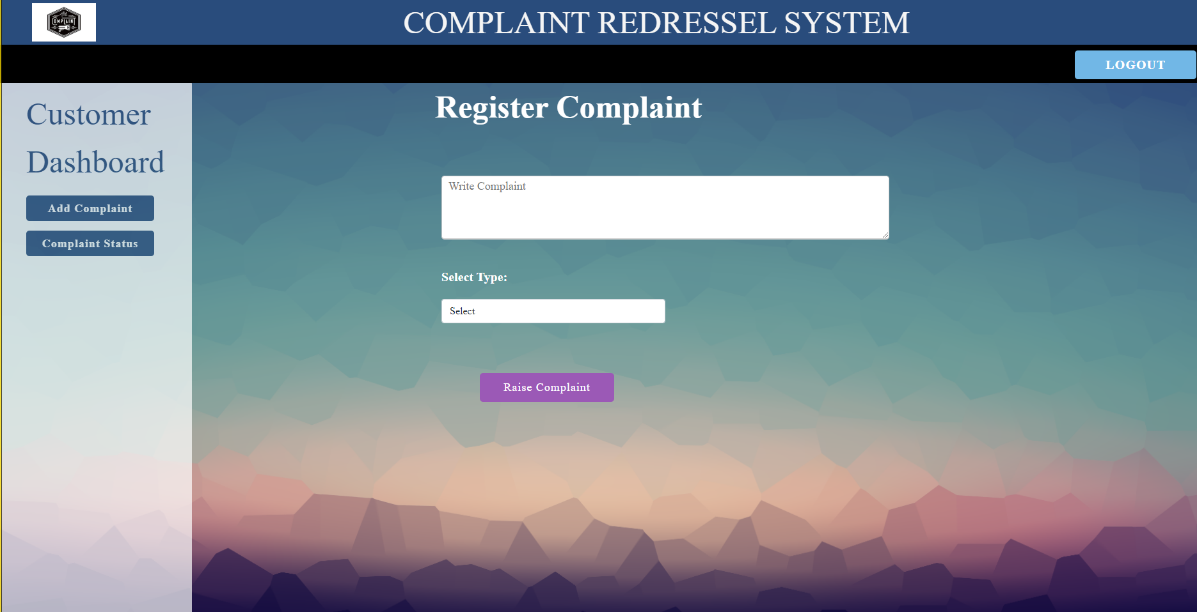
Customer can add Complaints:

Slide 33
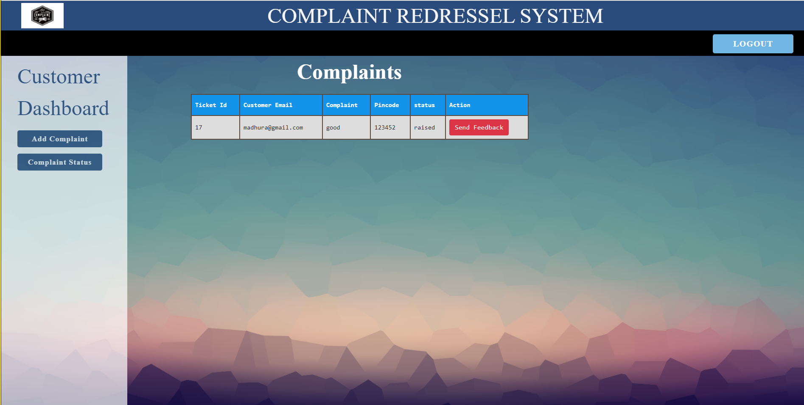
Customer can view Complaint Status:

Slide 34
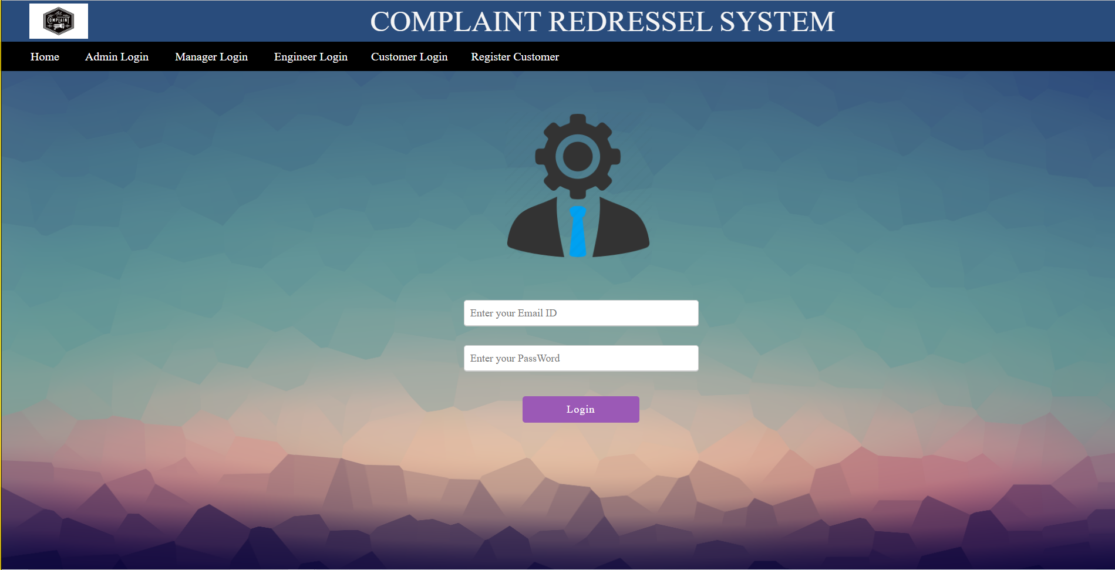
Manager login:

Slide 35
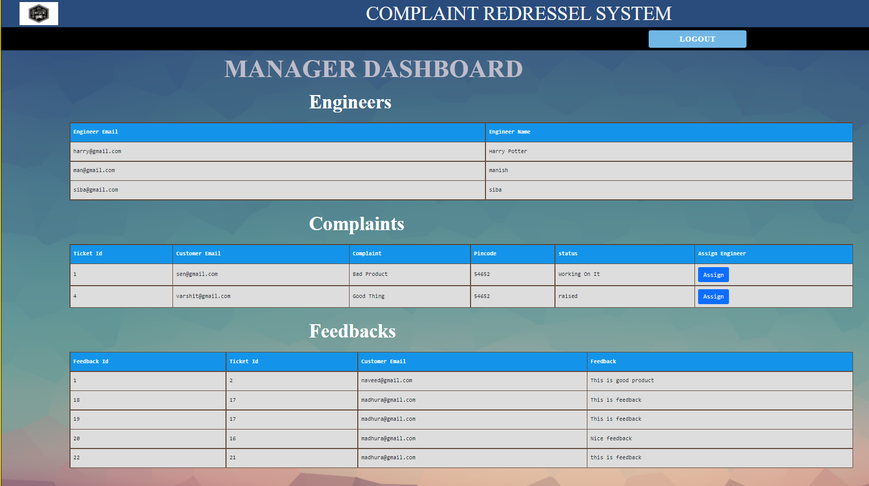
Manager can view Engineers , Complaints and Feedback:

Slide 36
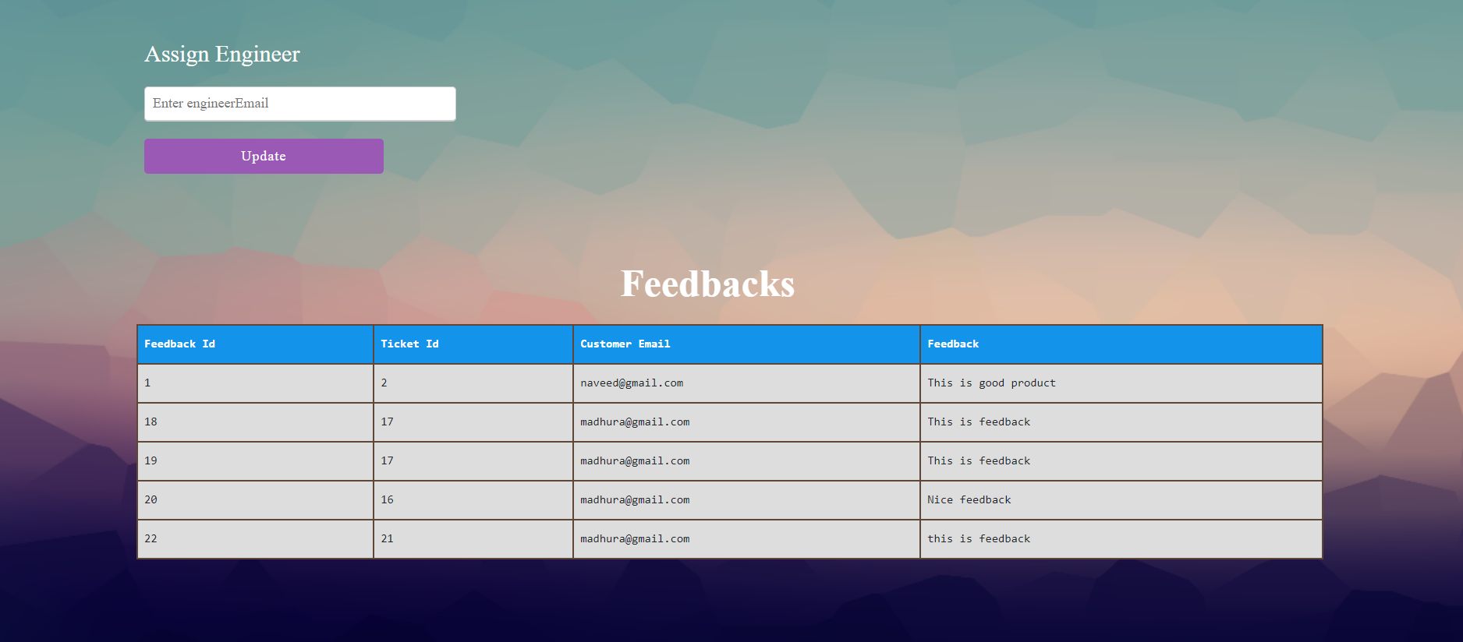
Manager can assign Engineer

Slide 37
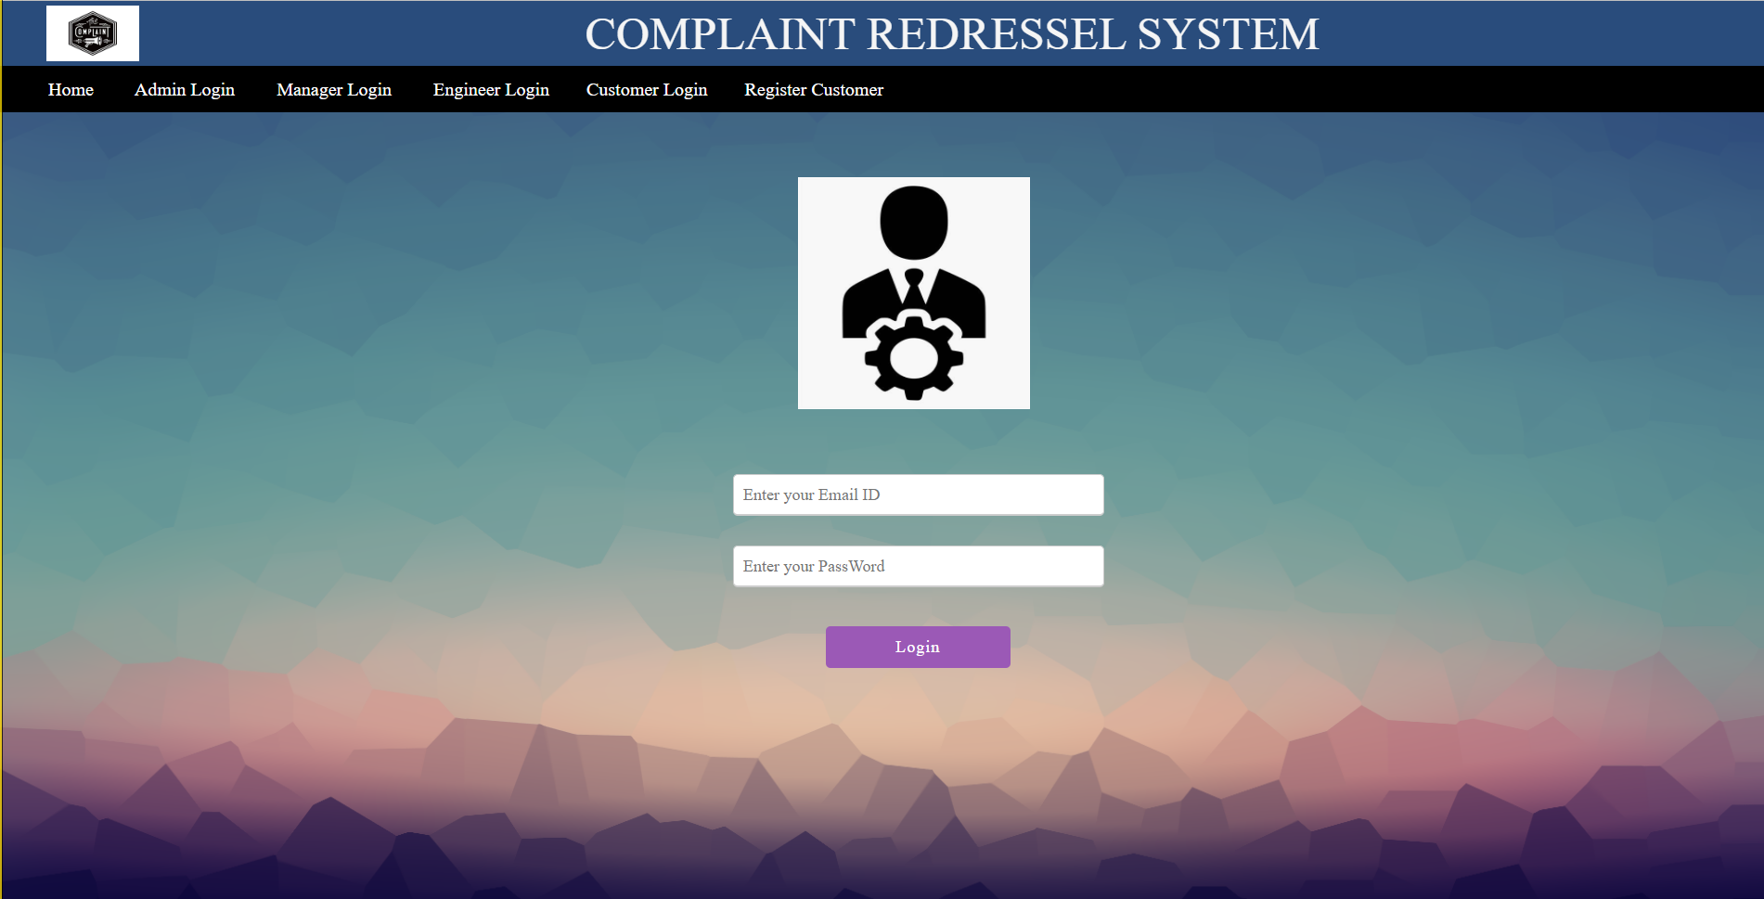
Engineer login:

Slide 38
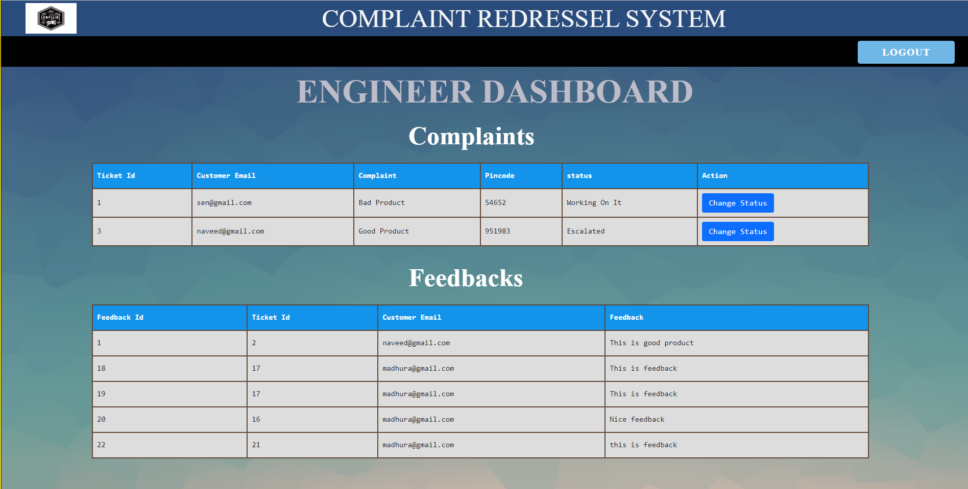
Engineers can view Complaints and Feedbacks:

Slide 39
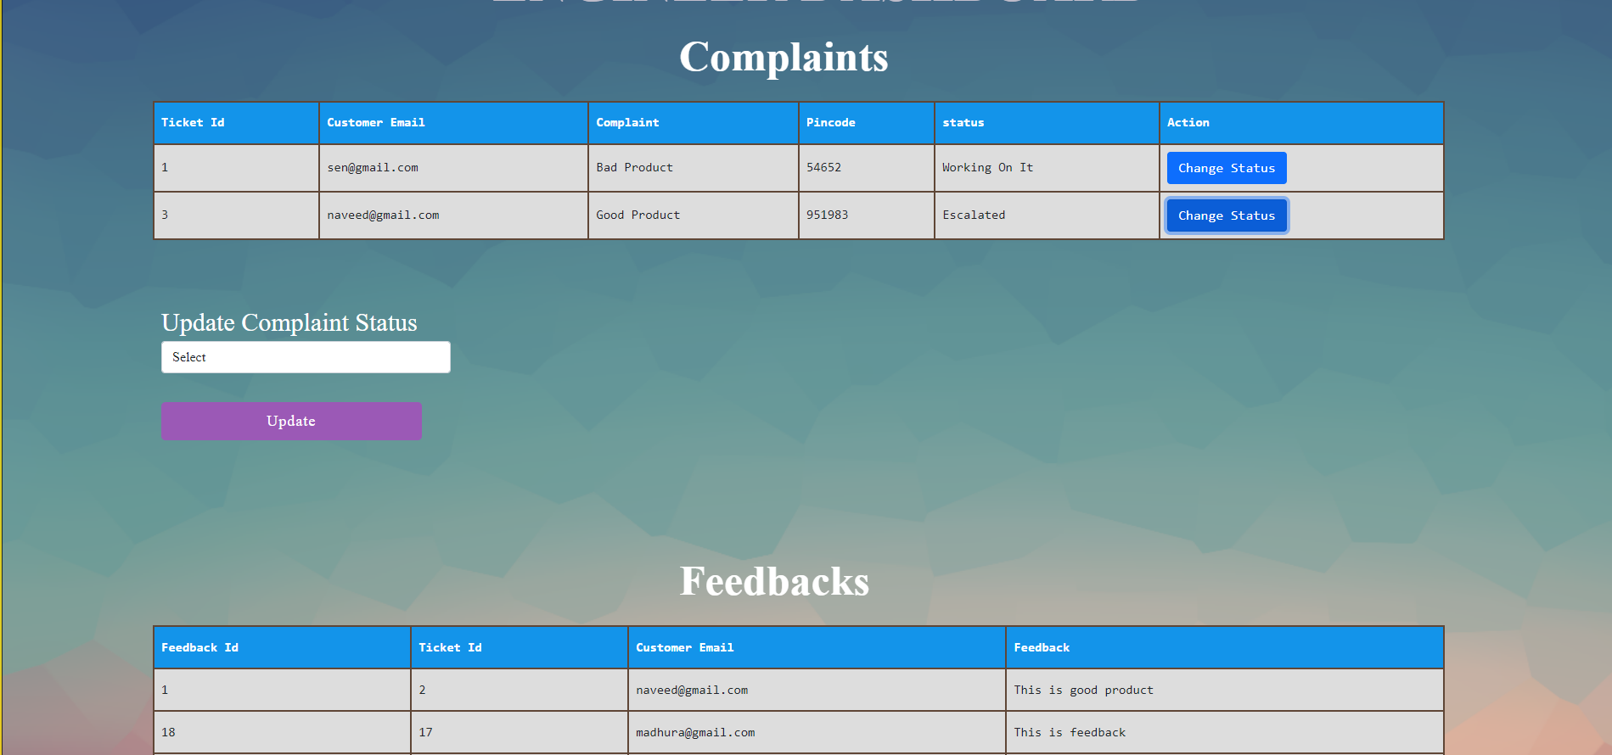
Engineer can update the status:

Slide 40
Future scope:
To improve customer satisfaction.
Manager and Engineer will have an option to update the password.
Admin will be able to update more than one field of manager and Engineer.
Validation for duplicate complaints.
Customer will receive acknowledgment via Email for update on complaints.

Slide 41
Conclusion:
User can raise a complaint on the system and check the status of same.
The Admin can add Manager and Engineer to the system.
Manager can assign Engineer for the complaints.
Engineer can work on the complaint and update the status.

Slide 42
Thank you

